Slide 1
Data Science???? What?????

Slide 2

Data Science???? What?????
Notes:
1:27 onwards: https://www.youtube.com/watch?v=KF6sLCeBj0s

Slide 3
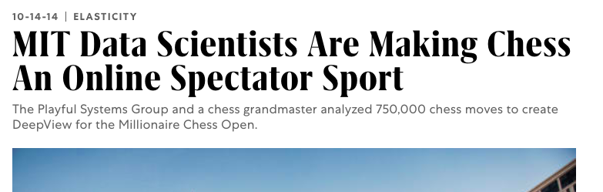
Deep Blue vs Kasparov Chess Master (1997)
https://www.youtube.com/watch?v=KF6sLCeBj0s

Slide 4
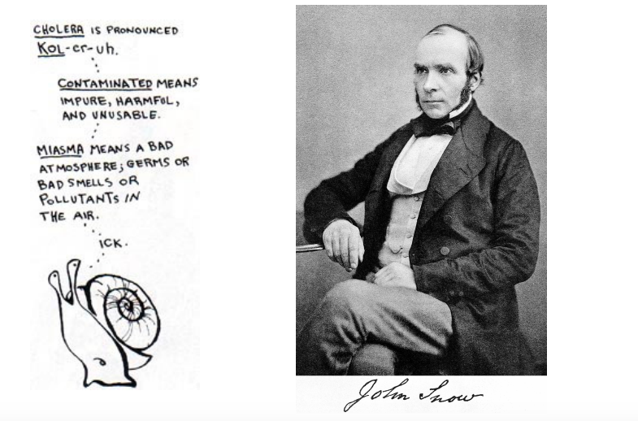
John Snow & Cholera (1854)
Notes:
https://ralucanicola.github.io/cholera-map-3D/

Slide 5
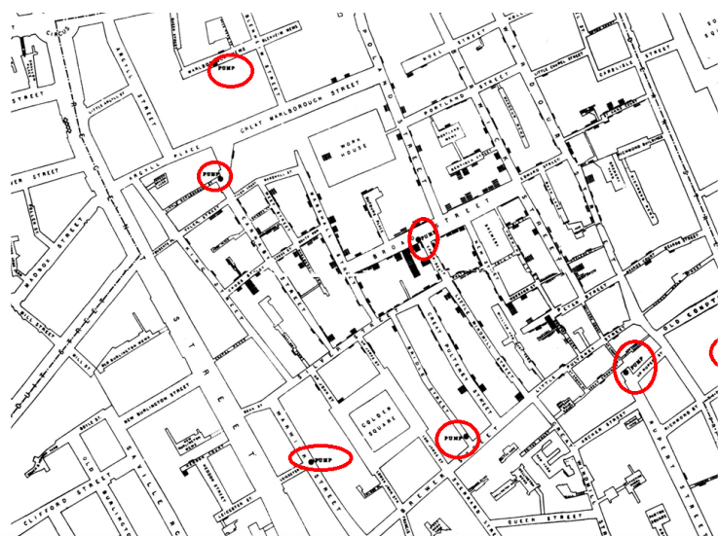

Slide 6
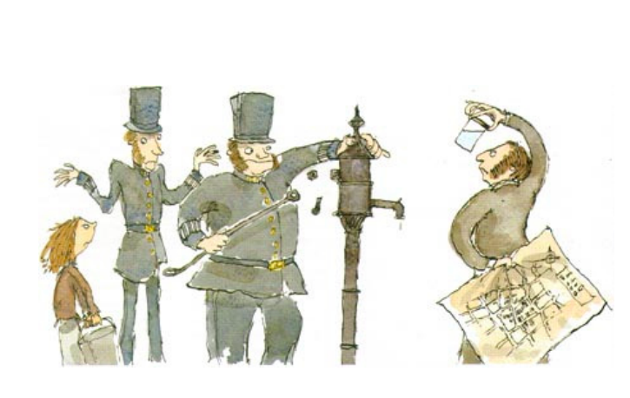
Notes:
Snow's map essentially proved that cholera was spread by contaminated water and disproved the prevailing miasma theory, which believed that diseases like cholera were transmitted by bad air.

Slide 7
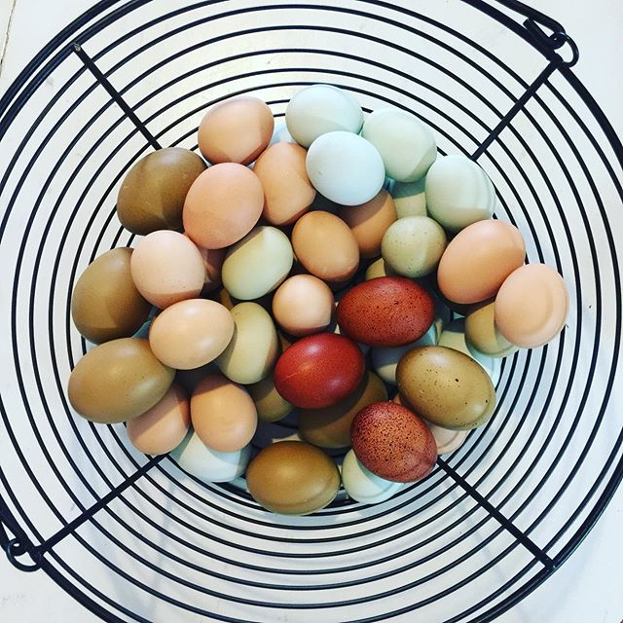
Notes:
Can you predict how many eggs your chickens will lay the next day? The next week?

Slide 8
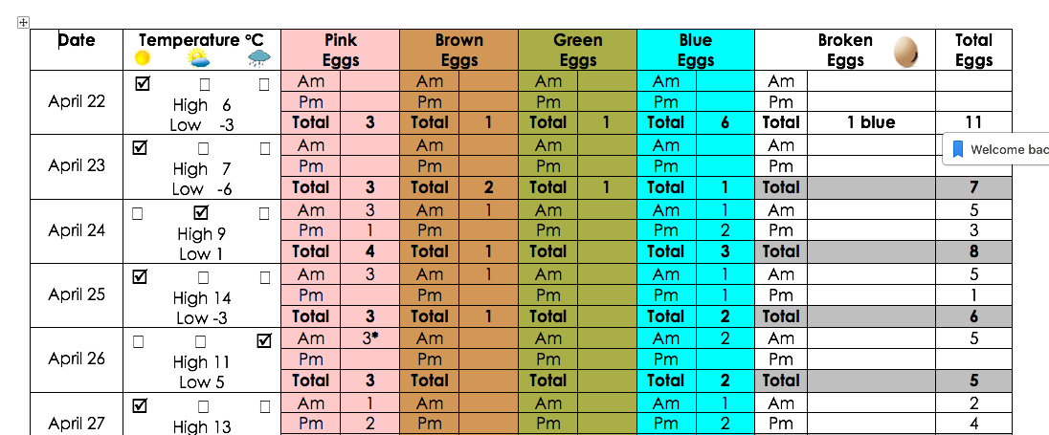

Slide 9
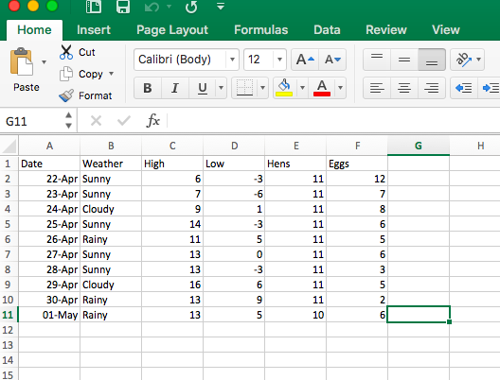

Slide 10
Let’s draw a chart

Slide 11
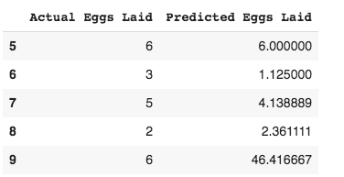
Our Results!?

Slide 12
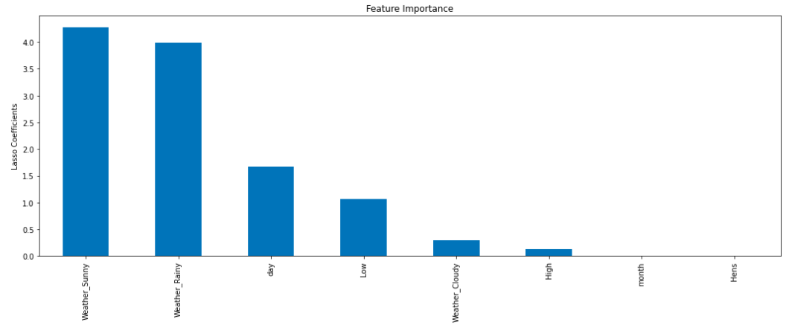
What was most important?

Slide 13
How can we get better results next time?
More data – lots of it!
Use a better model – we need to understand some math and learn how to code to improve this!
Better ideas of what increases or decreases egg output
Ask a chicken farmer for expert advice
Age of chicken?
Chicken happiness?
What does the chicken eat? Is it good for them?
Are the chickens safe? Or are they stressed?

